Slide 1
A quantitative description of membrane current and its application to conduction and excitation in nerve
A.L. Hodgkin & A.F. Huxley
The Journal of Physiology (1952) 117, 500-544
Clayton Mosher
PSYC 4/503c
September 8, 2010

Slide 2
Outline
Voltage clamp technique
Model of Na+ conductance during voltage clamp
A circuit model of an excitable cell
How well does the model predict membrane action potentials?
Adjusting the model for propagated action potentials
What can we learn from the model?
Limitations of the model and future directions

Slide 3
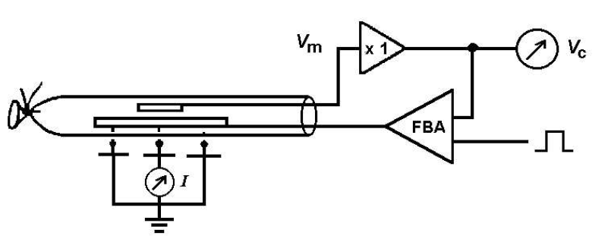
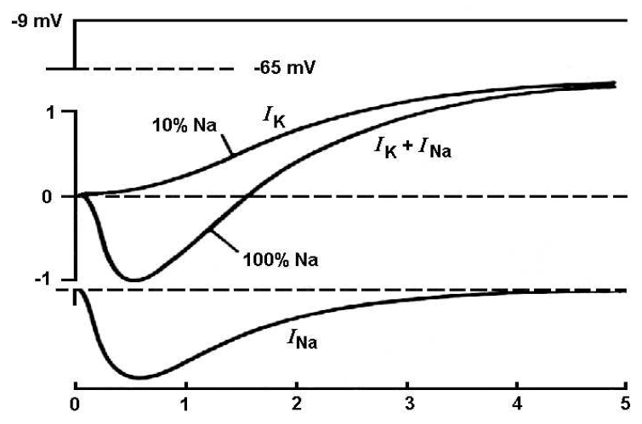
voltage clamping the squid giant axon
Nelson M. & Rinzel J. (2003). “The Hodgkin Huxley Model.” The book of genesis: Exploring realistic neural models with the General Neural Simulation System, pp29-50 [Fig. 4.1 AB]
V_{c} - V_{m}
depolarizing V_{c}
I

Slide 4
voltage clamping the squid giant axon
[movie] “The Squid and its Giant Nerve Fiber.” http://www.science.smith.edu/departments/ NeuroSci/courses/bio330/squid.html

Slide 5
modeling Na⁺ conductance (g_{Na})
[Fig. 6] Hodgkin A.L. & Huxley A.F. (1952) J. Physiol.
At rest (i.e., t=0) ... m(t=0)= m₀ and h(t=0)= h₀
Solving for these boundary conditions gives:
With the following simplifying assumptions:
g_{Na} at rest is small compared to g_{Na} during large >30 mV depolarizations → ignore m₀ term
inactivation is fairly complete at V < -30mV → ignore h∞ term
We arrive at the following equation:

Slide 6
modeling Na⁺ conductance (g_{Na})
[Fig. 6] Hodgkin A.L. & Huxley A.F. (1952) J. Physiol.
= 40.3 [1 – exp(-t /0.140)]³ exp(- t /0.67)
= 42.6 [1 – exp(-t /0.160)]³ exp(- t /0.67)
= 46.8 [1 – exp(-t /0.200)]³ exp(- t /0.67)
At rest (i.e., t=0) ... m(t=0)= m₀ and h(t=0)= h₀
= 39.5 [1 – exp(-t /0.189)]³ exp(- t /0.84)
Solving for these boundary conditions gives:
With the following simplifying assumptions:
g_{Na} at rest is small compared to g_{Na} during large >30 mV depolarizations → ignore m₀ term
inactivation is fairly complete at V < -30mV → ignore h∞ term
We arrive at the following equation:

Slide 7
modeling Na⁺ conductance (g_{Na})
[Fig. 6, 7, 8] Hodgkin A.L. & Huxley A.F. (1952) J. Physiol.
≈ 0.980 / 0.140 ms = 7.0 ms⁻¹

Slide 8
modeling Na⁺ conductance (g_{Na})
[Fig. 6, 7, 8] Hodgkin A.L. & Huxley A.F. (1952) J. Physiol.

Slide 9
modeling K⁺ conductance (g_{K})
[Fig. 3] Hodgkin A.L. & Huxley A.F. (1952) J. Physiol.

Slide 10
Circuit model of a neuron: unifying g_{Na} and g_{K} models
[Fig. 1] Hodgkin A.L. & Huxley A.F. (1952) J. Physiol.

Slide 11
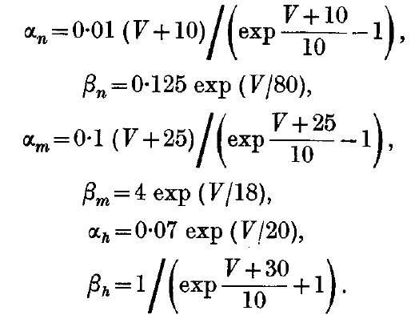
Circuit model of a neuron: unifying g_{Na} and g_{K} models
[Fig. 1] Hodgkin A.L. & Huxley A.F. (1952) J. Physiol.
Taken together with equations for g_{Na} and g_{K} …

Slide 12
How good is this model? – Predicting I during voltage-clamp
[Fig. 11] Hodgkin A.L. & Huxley A.F. (1952) J. Physiol.
Theoretical
Experimental

Slide 13
How good is this model? – Predicting membrane action potentials
[Fig. 12] Hodgkin A.L. & Huxley A.F. (1952) J. Physiol.
Theoretical
Experimental

Slide 14
How good is this model? – Predicting membrane action potentials
[Fig. 12] Hodgkin A.L. & Huxley A.F. (1952) J. Physiol.
Theoretical
2
1
3
4
Experimental

Slide 15
Extending the model to propagated action potentials…
[Fig. 15] Hodgkin A.L. & Huxley A.F. (1952) J. Physiol.
Theoretical
≈ 18.8 m/s
Experimental
21.2 m/s

Slide 16
What can the model tell us about … ionic g and I during an AP?
[Fig. 17, 18] Hodgkin A.L. & Huxley A.F. (1952) J. Physiol.
Conductance ( g )
Current ( I )

Slide 17
What can the model tell us about … AP refractory periods?
[Fig. 19, 20] Hodgkin A.L. & Huxley A.F. (1952) J. Physiol.

Slide 18
What can the model tell us about … AP refractory periods?
[Fig. 19, 20] Hodgkin A.L. & Huxley A.F. (1952) J. Physiol.

Slide 19
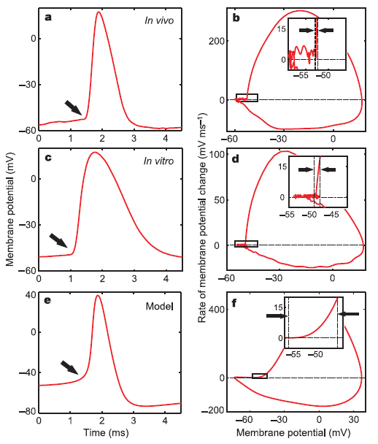
What are the limitations of the HH model? What do we do now?
[Fig. 1] Naundorf B. et al. (2006) Nature: 440, 1060-63
“An equally satisfactory description of the voltage clamp data could no doubt have been achieved with equations of very different form, which would probably have been equally successful in predicting the electrical behavior of the membrane. […] the success of the equations is no evidence in favour of the mechanism of permeability change that we tentatively had in mind when formulating them” (Hodgkin and Huxley, 1952).
slight differences in AP form (e.g., sharpness of peak, fall of action potential
fails to adequately predict ionic fluxes (too much K⁺ moves, too little Na ⁺)
slow changes are left unaccounted for (e.g., no replenishing of K+)
model is based on in vitro recordings
applicability to other excitable tissues
…

Slide 21
modeling K⁺ conductance (g_{K})
[Fig. 3] Hodgkin A.L. & Huxley A.F. (1952) J. Physiol.
At rest (i.e., t=0) ... V(t=0)=0 and n(t=0)=
Solving for these boundary conditions gives:
where…
and…
Substituting this result into equation (6), we’re able to compute values that can then be compared to the experimental results:

