Slide 1
The Learning Network
Derek Clarke and Jessica Brittain
12/1/2010

Slide 2
  “Artificial neural networks (ANNs) are biologically inspired computer programs designed to simulate the way in which the human brain processes information. ANNs gather their knowledge by detecting the patterns and relationships in data and learn (or are trained) through experience, not from programming. An ANN is formed from … artificial neurons … connected with coefficients (weights), which … are organised in layers.”
  –Kustrin & Beresford, J Pharm Biomed Anal, 2000.

Slide 3
Origins
-Cowan, Scientific American, 1979

Slide 4
Evolution
McCulloch & Pitts
Hebb
Turing
  B-Type Machine
  Computers…

Slide 5
Modern
Neural Networks: the official journal of the International Neural Network Society.
Many types of ANNs:
  Feedforward
  Recurrent
  Backpropogation
    Learning correlations
  Self-Organizing Maps (SOMs)
    Object recognition

Slide 6
Applications
Predicting stock prices/ weather/ eye movements
  Araujo, 2010, Kettner et al, 2002
Medical diagnosis
  Arrythmias, ictal neural patterns
  Sufi et al, 2010, Sufi & Khalil, 2009,
  “…neural network classifiers are a very popular choice for medical decision making and they have been shown to be very effective in the clinical domain…” -Mazurowski et al, Neural Networks, 2008
Drug design, protein structure
  Sardari & Sardari, 2002
Object recognition
  Fingerprints, faces

Slide 7
Transfer functions
Model Thresholds
Sigmoidal
Hyperbolic Tangent

Slide 8

Feed Forward
How many interneurons (hidden neurons)
  2n+1, where n = # inputs – Kurkova, Neural Networks, 1992
  For two hidden layers:
    1st layer =
    2nd layer =
    Where N = # Training samples, m = # outputs
      D.Stathakis, Int J Remote Sensing, 2009

Slide 9
Training
Supervised learning
  Backpropogating
Unsupervised
  Feedforward

Slide 10
Programs
Matlab
  Integrate-and-fire
  Not relevant for biophysical model
EMERGENT
  Working with multiple layers
  Many neurons at once
Stuttgart Neural Network Simulator
JavaNNS
Others…

Slide 11
Biophysical NN?
The goal of this work was to replicate some of the computational capabilities of ANN’s using biophysical neural networks

Slide 12
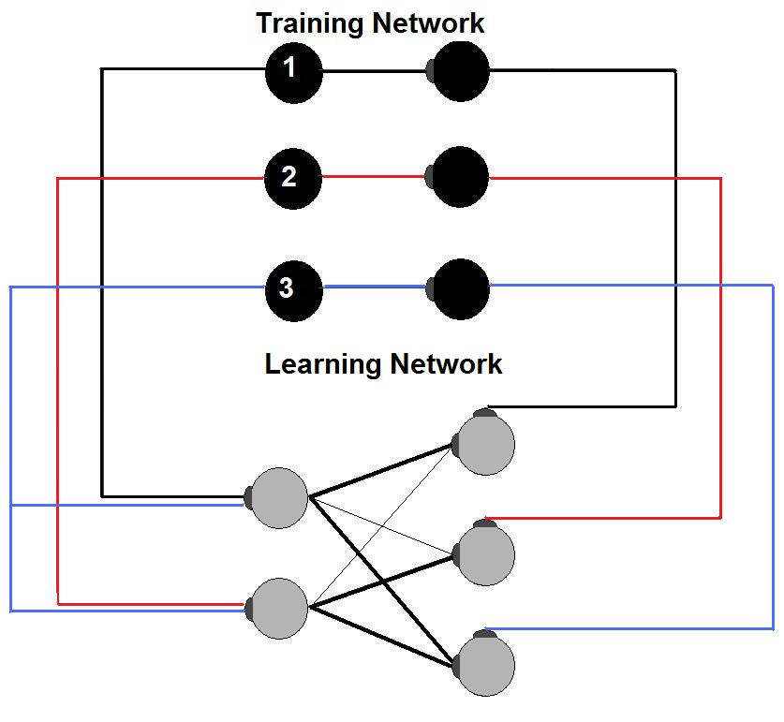
Implementation

Slide 13
Design
Three ‘master’ neurons are stimulated in sequential order
These neurons have two output axons
  One relays input into ‘Learning network’ (LN)
  The other stimulates a ‘Training network’ (TN), which relays the signal to the output neurons
After training, connection of ‘training’ neurons to interneurons is removed
If the training was successful, the network will respond to inputs with the correct output (better than control network trained without TN connections)

Slide 14
Basic Coding
FixStim() = Delivers stimulation to training neurons
Fix() = Fixes connection weights to the training interneurons and output neurons
Layer() = Defines feed-forward connections of the learning network
Train() = Connects training neurons to output
Trained() = Removes training network
UpdateW2() = Selectively updates weights outside LN
  (Allows TN to LN weight matrix to be modified without affecting LN after training)

Slide 15
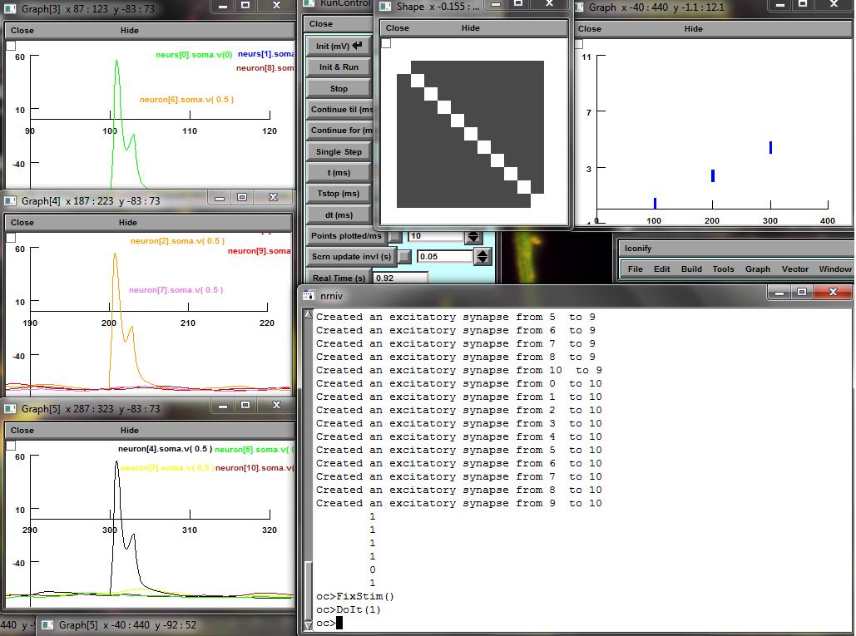
FixStim()

Slide 16
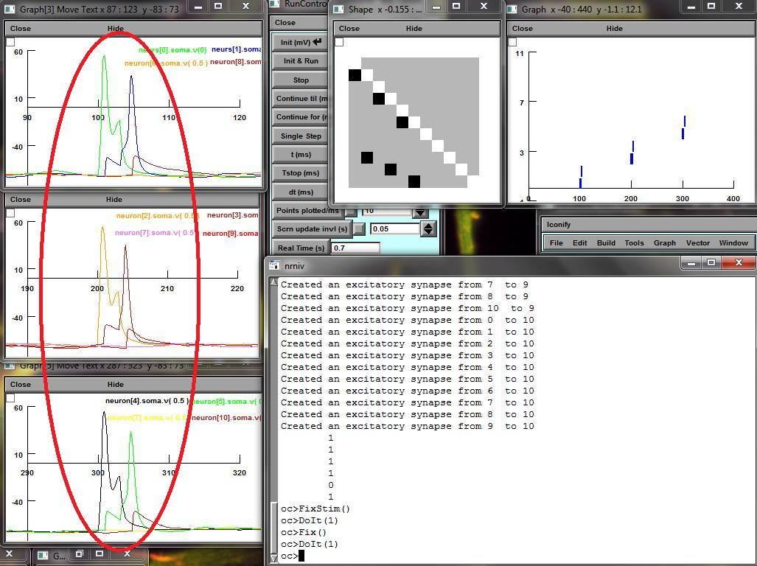
Fix()

Slide 17
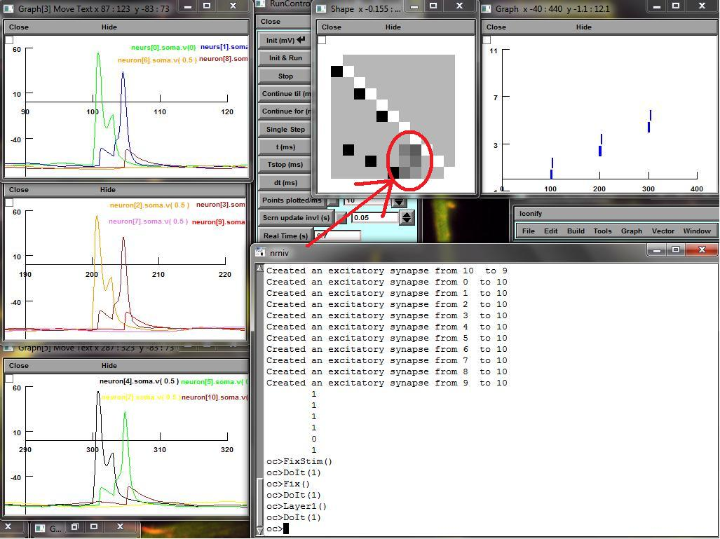
Layer()

Slide 18
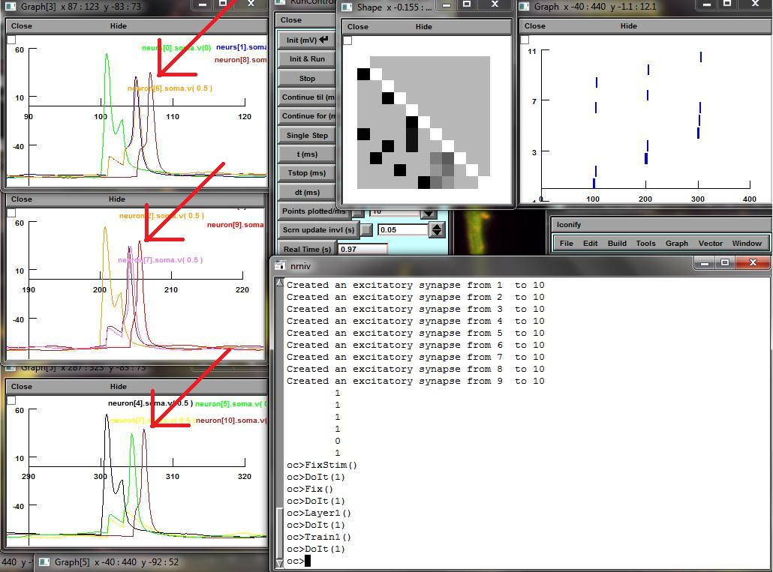
Train()

Slide 19
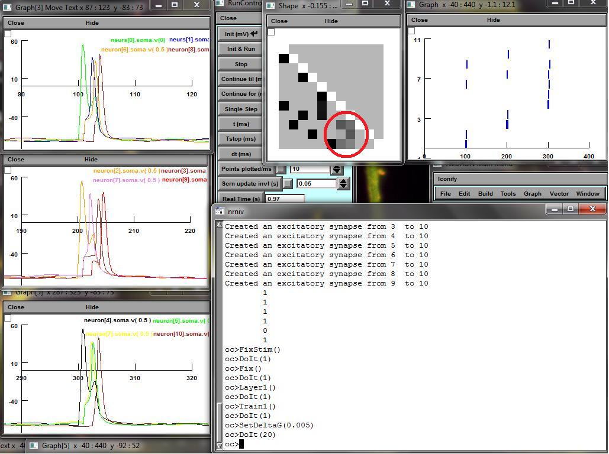
DoIt(20)

Slide 20
Tuning Parameters
This simple network was useful for tuning learning parameters, as well as formulating the experimental design
  Background noise was silenced by narrowing the inhibitory STDP
  The optimal connection weight for the fixed training network was found at 0.40
  The optimal weight in the learning network, for 30 iterations at a DeltaG of 0.005, was 0.20, or varied randomly between 0.15-0.25
    Permitted selective training without “overtraining”

Slide 21
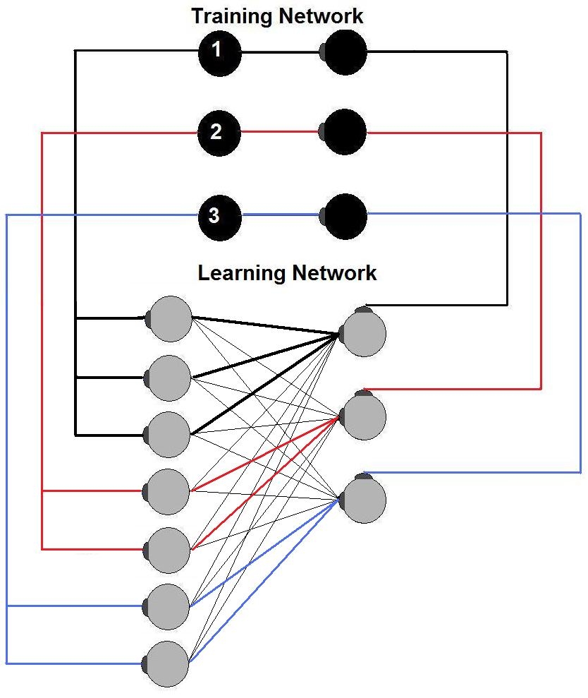
Increasing complexity
Using the simple ‘2n+1’ rule, the input layer was increased to 7 neurons
Each ‘master’ neuron was connected to all inputs, however for simplicity inputs were originally divided into 3-2-2 cohorts

Slide 22
Simple experiment
The intent of this experiment to teach the 7x3 network to categorize “phone numbers” i.e. ‘480-5500’ from ‘203-0068’
The network was unable to categorize these numbers, outputs became random
In an attempt to improve the power of the network, additional ‘hidden layers’ were added

Slide 23
Additional layers
First an additional layer of 7 neurons was added, without success
Finally, a ‘funnel’ shaped network, using the +
rule, creating a 7x17x5x3 network
-Stathakis, Int J of Remote sensing, 2007

Slide 24
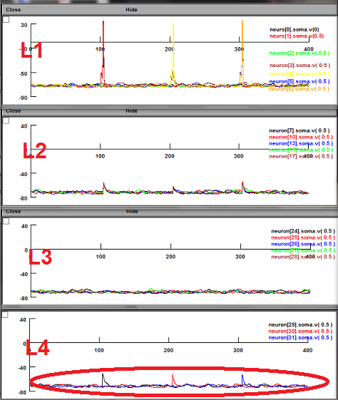
Various ratios of connection weights were tested in the four layers of this network

Slide 25
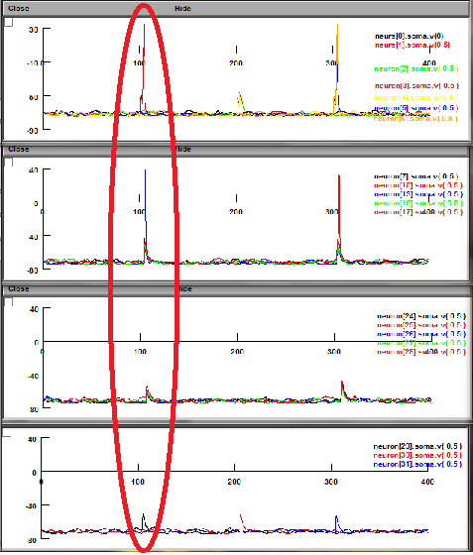
Although the synaptic currents were able to carve a path through this network, the training pulses were unable to select for the desired outputs

Slide 26
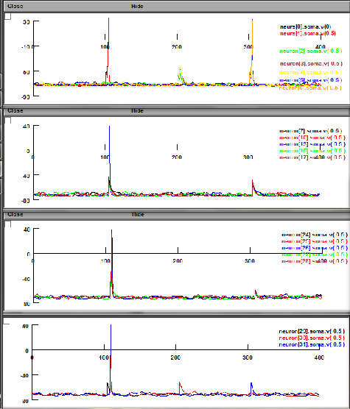
The trouble with this result was that the output neurons fired inconsistently

Slide 27
Data

Slide 28
What Happened?
Perhaps the probability of the target output neuron firing was actually greater with the training network than random chance, but the effect was not seen due to the brief training period
  Decreasing DeltaG, while increasing training duration, and comparing to random untrained firing could test for this possibility
The connection weights of the hidden layers may have been too high, causing a fast rate of LTP leading to ictal firing patterns
  In the complex network, unlike the simple network, firing of the output layer was observed in the absence of the TN
  It may be possible to tune the weight parameters of the LN so the hidden layers are only capable of producing subthreshold EPSP’s in the output layer

Slide 29
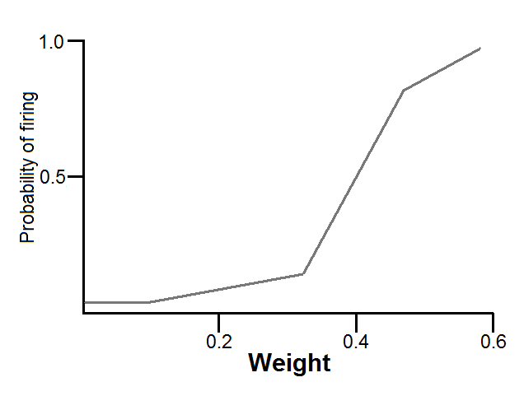
Methods for Improvement
Finer weight parameters could be determined by line fitting the correlation of connection weight to probability of firing, or connection weight to EPSP, to find the ‘threshold’ weight

Slide 30
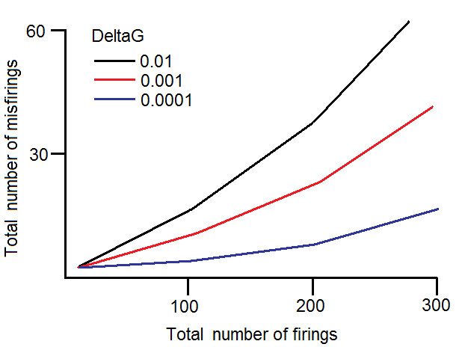
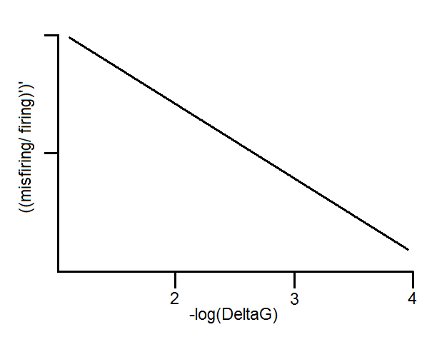
Methods for Improvement
An optimum DeltaG parameter could be found by plotting a curve of the total number of errors over time for various DeltaG values

Slide 31
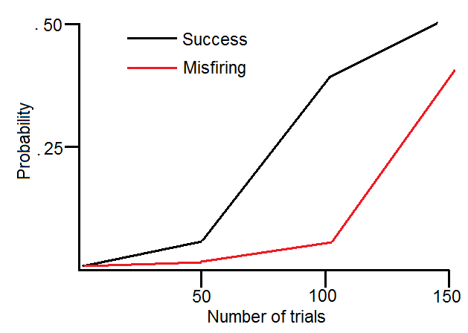
Methods for Improvement
The total number of misfirings over time versus successes could be plotted to determine the optimum number of training iterations

Slide 32
Training nets in brain?
- Cowan, Scientific American, 1979

Slide 33
Abbott & Regehr, Nature, 2004
Increased synaptic
complexity?

Slide 34
Destexhe & Marder, Nature, 2004
Increased
output complexity?

Slide 35
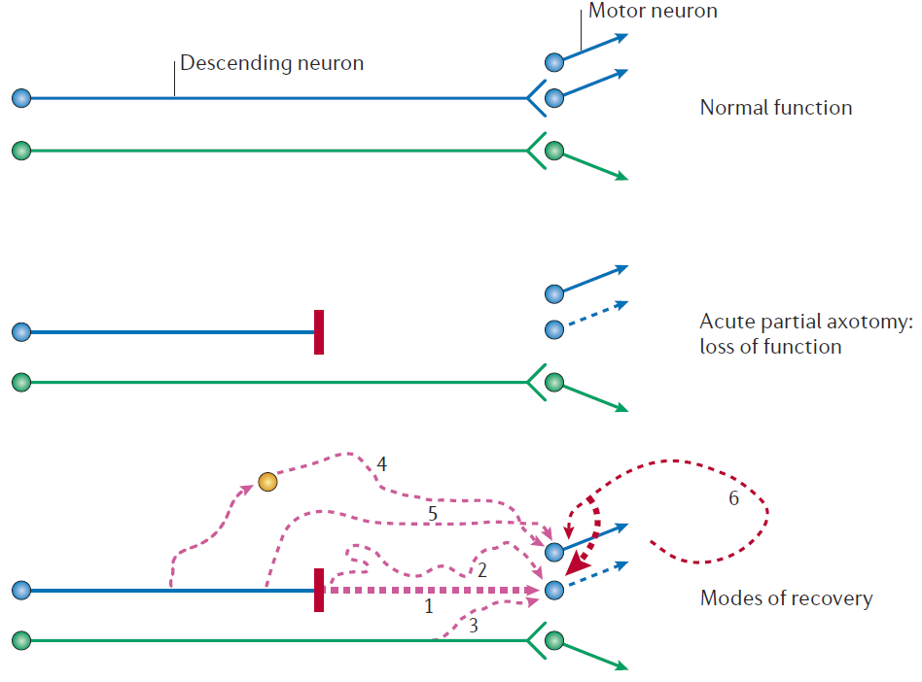
Regeneration
Sensorimotor feedback
- Harel & Strittmatter, Nature Reviews Neuroscience, 2006

Slide 36
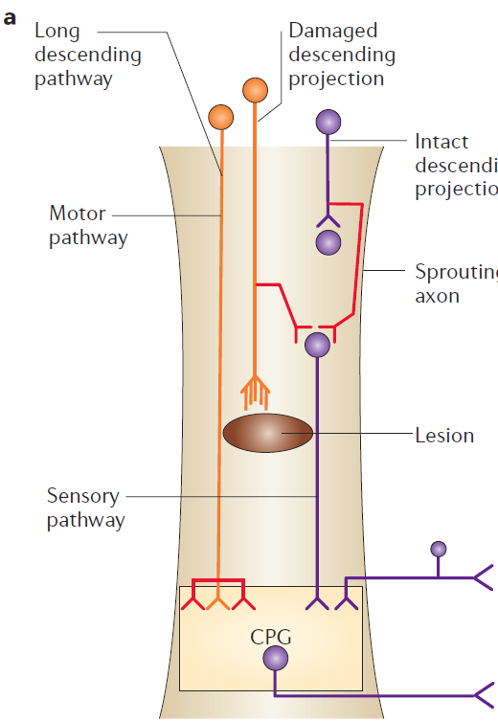
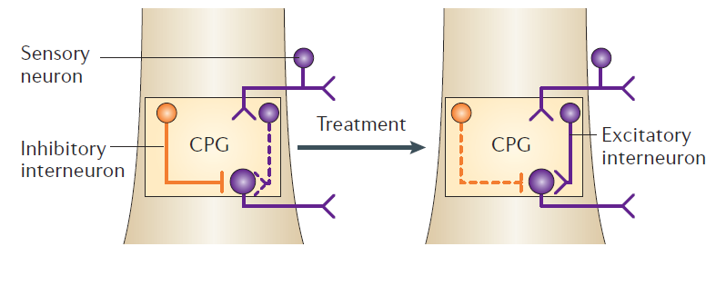
Training axon regeneration
-Bradbury & McMahon, Nature Reviews Neuroscience, 2006

Slide 37
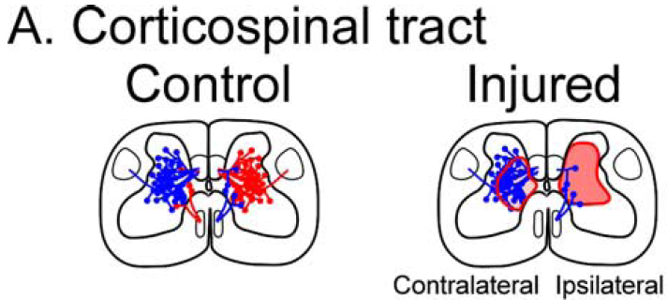

Slide 38
-Thuret, Nature Reviews Neuroscience, 2006

Slide 39
Future of Neural Nets
Robots
  iCub
AI?
-Metta et al, Neural Networks, 2010

